Slide 1
Predicting Salary
Using cost of living index
By Tafani Rabbani Hady Nourallah
Machine Learning Projects

Slide 2
About project
In this project we would like to identify of the possibility of predicting an average of salary in a city by knowing the Cost of Living Index. Cost of Living Index is data that usually used by people who want to move to other city.
The 3 main data that is provided by COLI are rent index, groceries index, and restaurant index. The index is a percentage of price comparison with prices in New York, USA. For example if a city has groceries index of 30, it means the groceries price of that city is 30% of price in New York.

Slide 3
Previous work
location
Contract type
category
salary

Slide 4
The Dataset

Slide 5


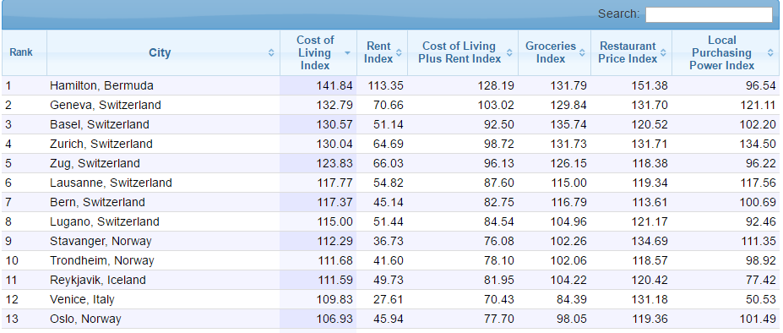
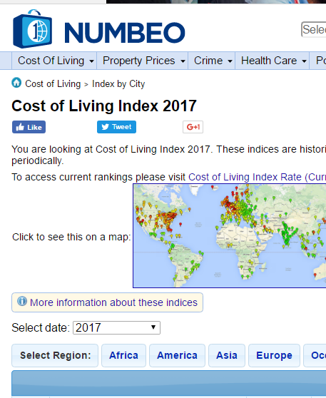
Source
The data that we use is coming from Numbeo.com cost of living index early 2017 data. The cost of living index table is free and published publicly in the internet, and so it’s not a sensitive data and we have the right to use it for this project.

Slide 6
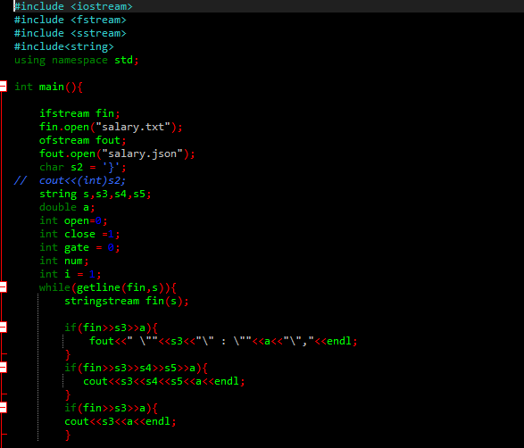
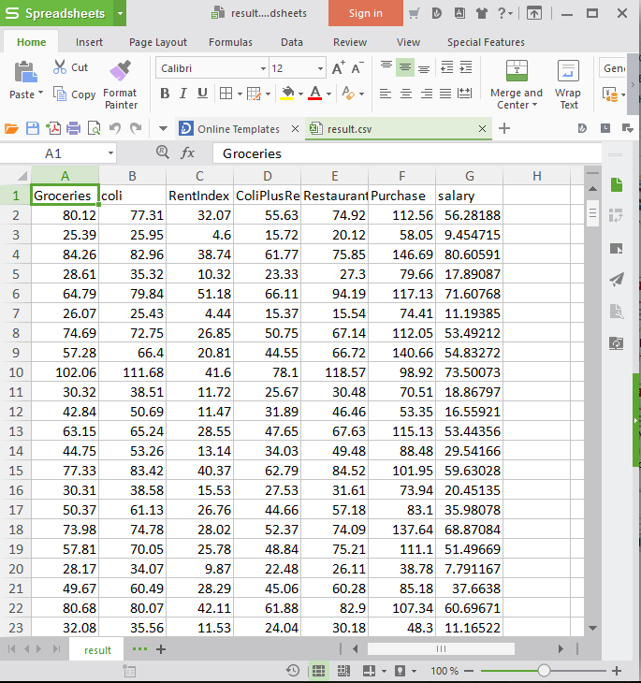
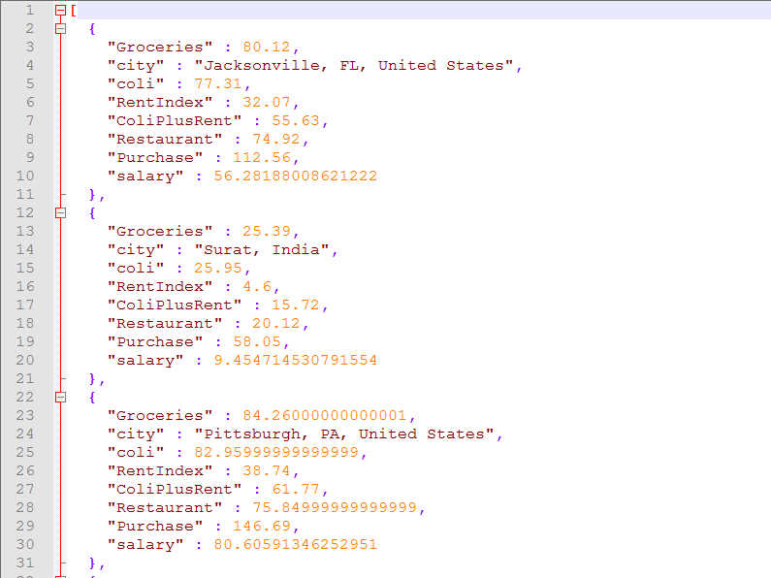
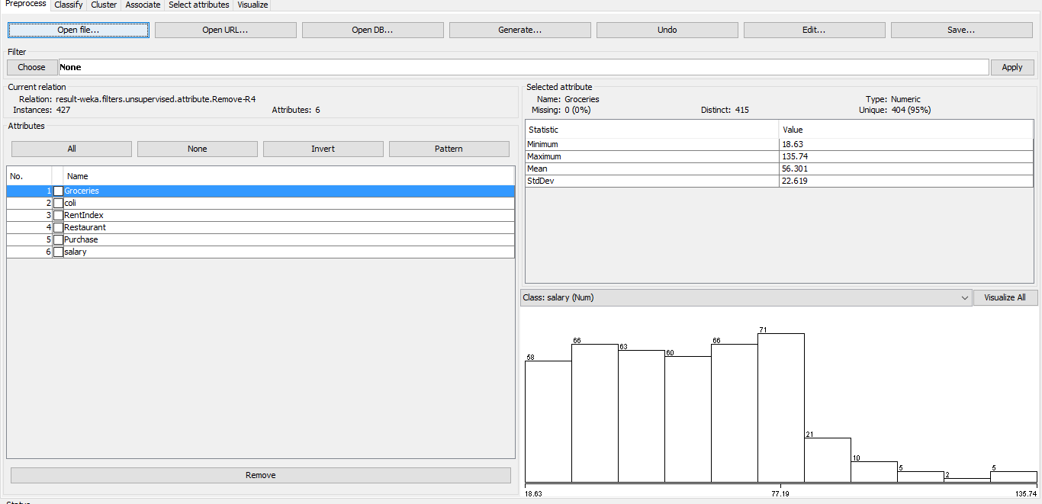
Json
CSV
Converting data from html structure to JSON structure
Convert json to csv and upload it in WEKA

Slide 7
Machine Learning Method
Linear regression Getting a linear function to calculate the prediction
M5P tree Having a decision tree and multiple rule to chose a different linear functions

Slide 8
Linear Regression
Using 6 Attributes:
-Groceries
-coli
-RentIndex
-Restaurant
-Purchase
-salary
Linear Regression Model:
salary =
0.192 * Groceries + 0.5657 *RentIndex +
0.1827 * Restaurant + 0.3471 * Purchase +
-25.0892
=== Summary ===
Correlation coefficient 0.9818
Mean absolute error 3.9472
Root mean squared error 5.3029
Relative absolute error 16.4483 %
Root relative squared error 18.9396 %
Total Number of Instances 427

Slide 9
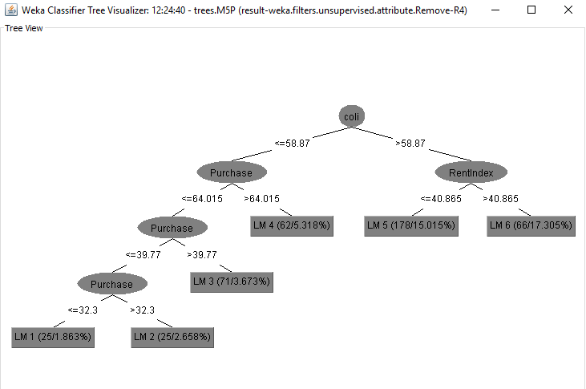
M5P Tree
Using 6 Attributes:
-Groceries
-coli
-RentIndex
-Restaurant
-Purchase
-salary
=== Summary ===
Correlation coefficient 0.9914
Mean absolute error 2.5178
Root mean squared error 3.6627
Relative absolute error 10.4931 %
Root relative squared error 13.0949 %
Total Number of Instances 427
Produces 6 rules.

Slide 10
The M5P linear models
LM num: 1
salary =
0.001 * Groceries
+ 0.1613 * coli
+ 0.1088 * RentIndex
+ 0.0226 * Restaurant
+ 0.2363 * Purchase
- 8.4344
LM num: 2
salary =
0.001 * Groceries
+ 0.1901 * coli
+ 0.1088 * RentIndex
+ 0.0226 * Restaurant
+ 0.1514 * Purchase
- 6.46
LM num: 3
salary =
-0.0394 * Groceries
+ 0.2381 * coli
+ 0.2631 * RentIndex
+ 0.0226 * Restaurant
+ 0.2782 * Purchase
- 13.3474
LM num: 4
salary =
0.0145 * Groceries
+ 0.3441 * coli
+ 0.3059 * RentIndex
+ 0.0294 * Restaurant
+ 0.2639 * Purchase
- 19.2371
LM num: 5
salary =
0.0111 * Groceries
+ 0.3565 * coli
+ 0.5736 * RentIndex
+ 0.1169 * Restaurant
+ 0.4203 * Purchase
- 43.3311
LM num: 6
salary =
0.0111 * Groceries
+ 0.6368 * coli
+ 0.5094 * RentIndex
+ 0.0247 * Restaurant
+ 0.5848 * Purchase
- 74.3448

Slide 11
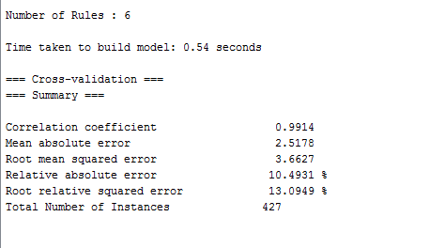
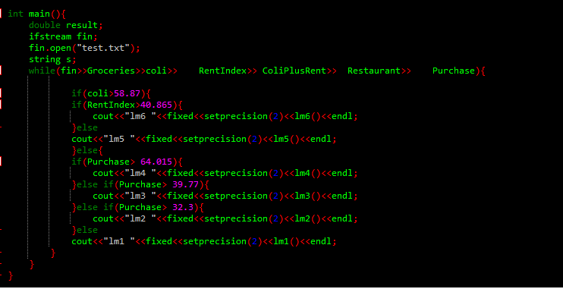
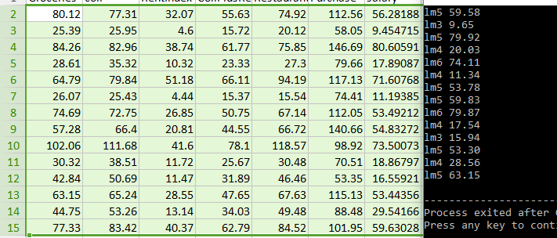
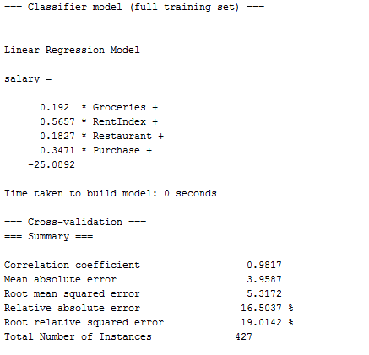
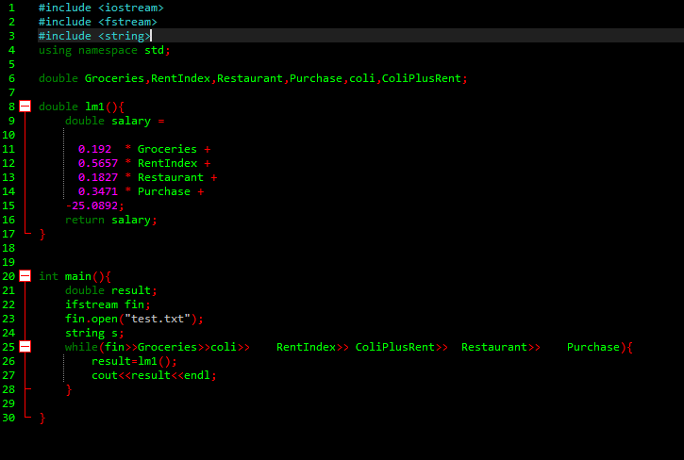
THE RESULT

Slide 12
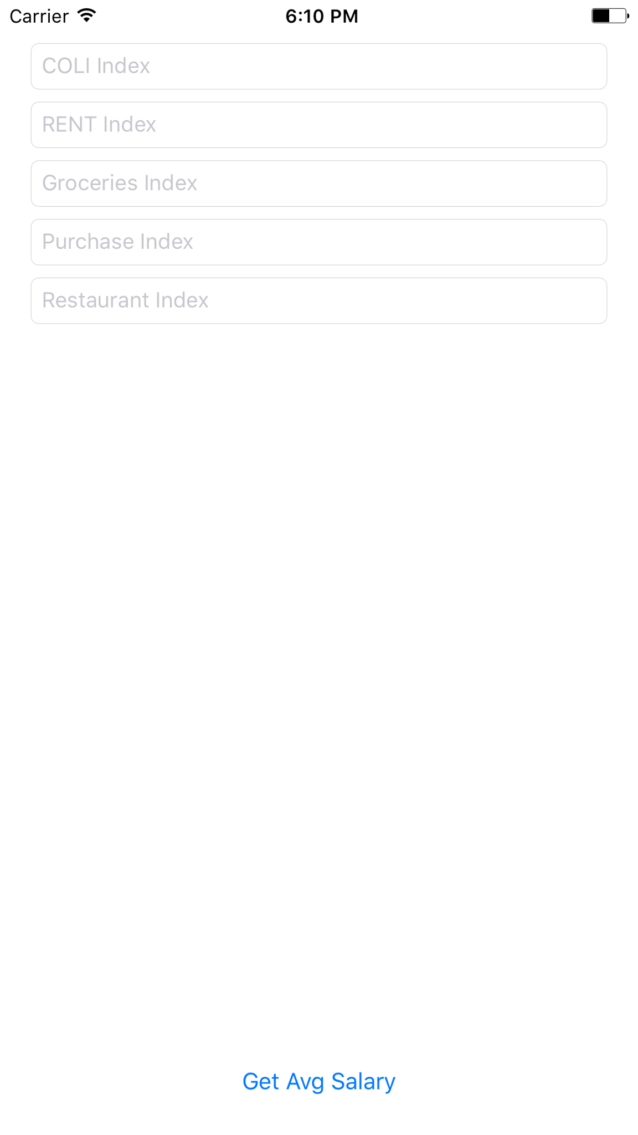
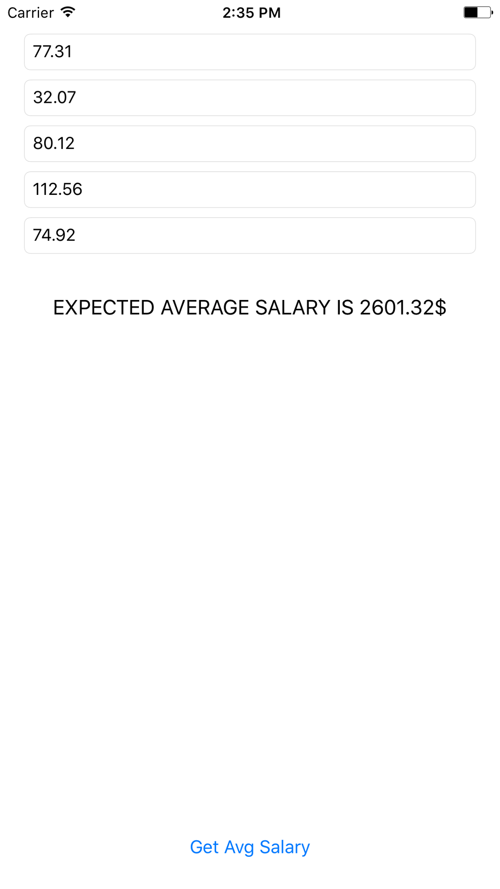
The Conclusion
Using expense data of a city we can closely predicted the average salary in that city.
In the future of this project
We would like to have geographic information, contract type and puting category of jobs.

